Slide 1
ibm future skill requirements
LAHMAMSSI Abdelhak
13/09/22

Slide 2
• Executive Summary
• Introduction
• Methodology
• Results
• Visualization – Charts
• Dashboard
• Findings & Implications
• Conclusion
• Appendix

Slide 3
SUMMARY
• Relevant skills required in the field of IT and business consulting are ever-changing and evolving.
• It is important to identify future skill requirements and trends to keep pace with changing technologies and remain competitive.
• This presentation will show current and future trends in Programming Languages, Databases, Platforms and WebFrames.
• Overall, the aim in identifying future skill requirements and trends is to help the firm make more informed datadriven hiring and budgetary decision

Slide 4
INTRODUCTION
• This presentation has been created for stakeholders and business decision makers within the global IT and business consulting services firm.
• The presentation will help identify future skill requirements in the global IT sector necessary for the firm to keep pace with changing technologies and remain competitive.
• Recommendations will be stated based on the analysis

Slide 5
METHODOLOGY
• Using a modified subset of the Stack Overflow dataset¹, the data was wrangled in order to remove duplicates, impute missing values and normalize data.
• Next, the data underwent exploratory analysis in order to find the distribution of data, presence of outliers and determine the correlation between different columns in the dataset.
• The data was then used to visualize the distribution, the relationship between two features and the composition and comparison of data.
• Finally, after downloading two files², which are also a modified subset of the StackOverflow dataset, Cognos Dashboard Embedded (CDE) was used to create the “Current Technology Usage”, “Future Technology Trends” and “Demographics” slides.
• Appendix
• To obtain average annual salaries web scraping was used to extract information from a website then saved to a csv file.

Slide 6
RESULTS

Slide 7
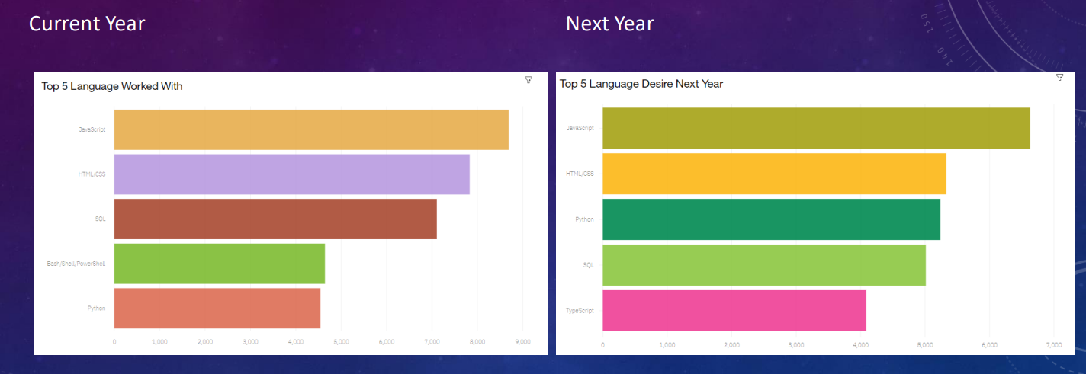
PROGRAMMING LANGUAGE TRENDS

Slide 8
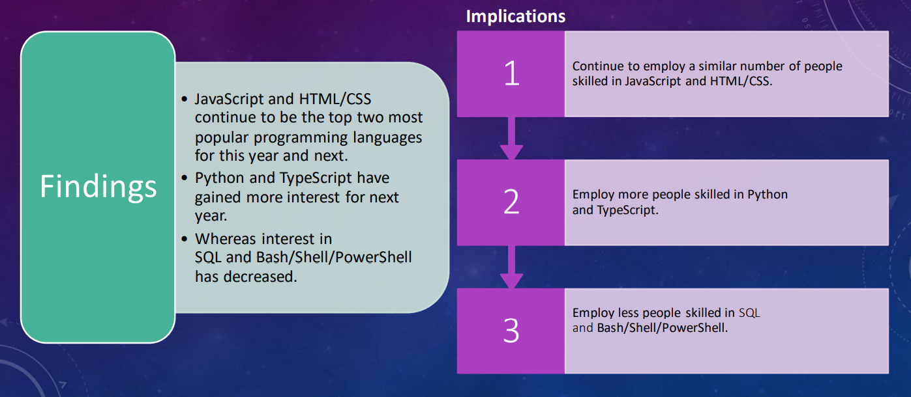
PROGRAMMING LANGUAGE TRENDS - FINDINGS & IMPLICATIONS

Slide 9
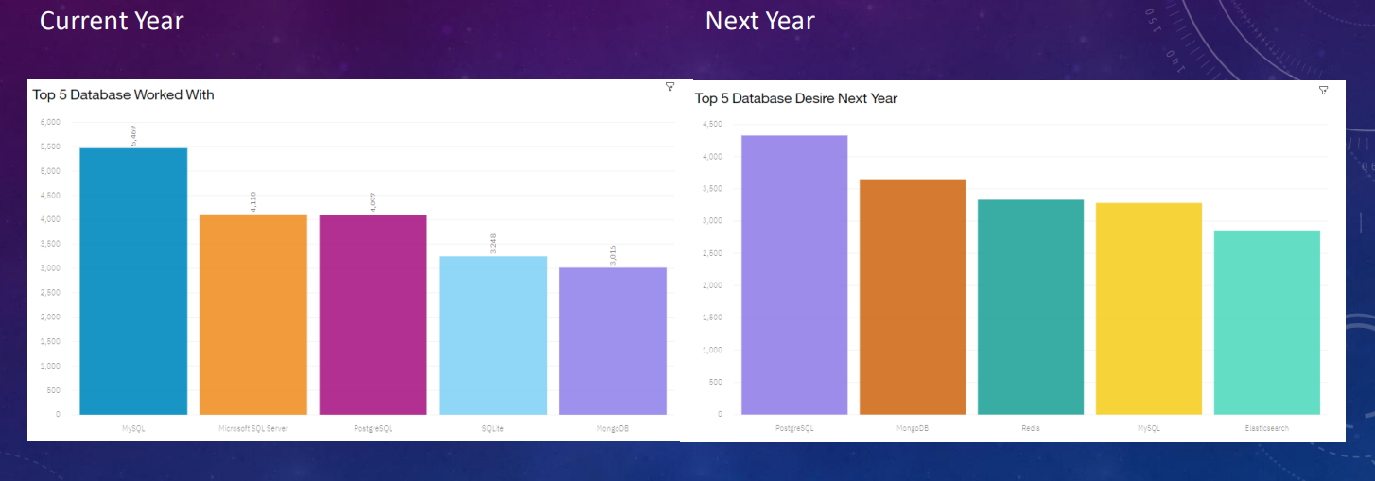
DATABASE TRENDS

Slide 10
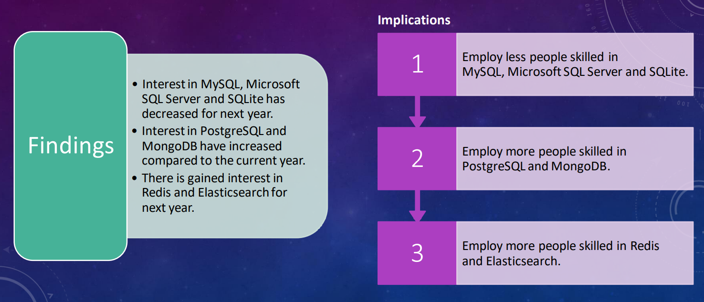
DATABASE TRENDS - FINDINGS & IMPLICATIONS

Slide 11
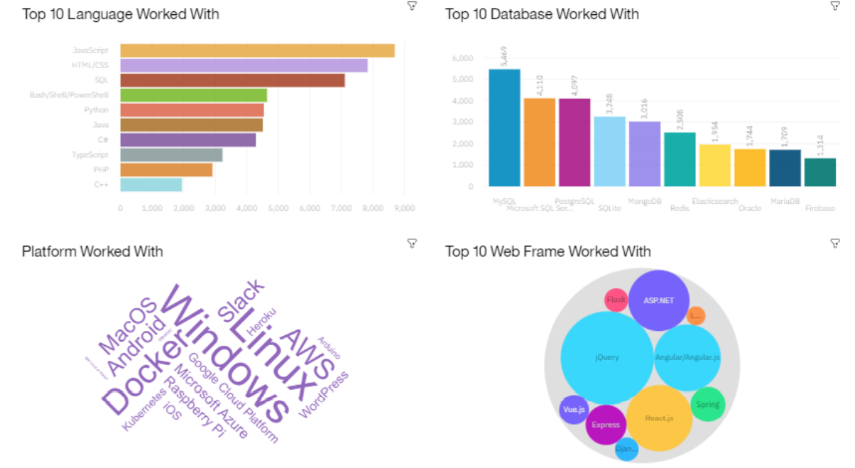
DASHBOARD

Slide 12
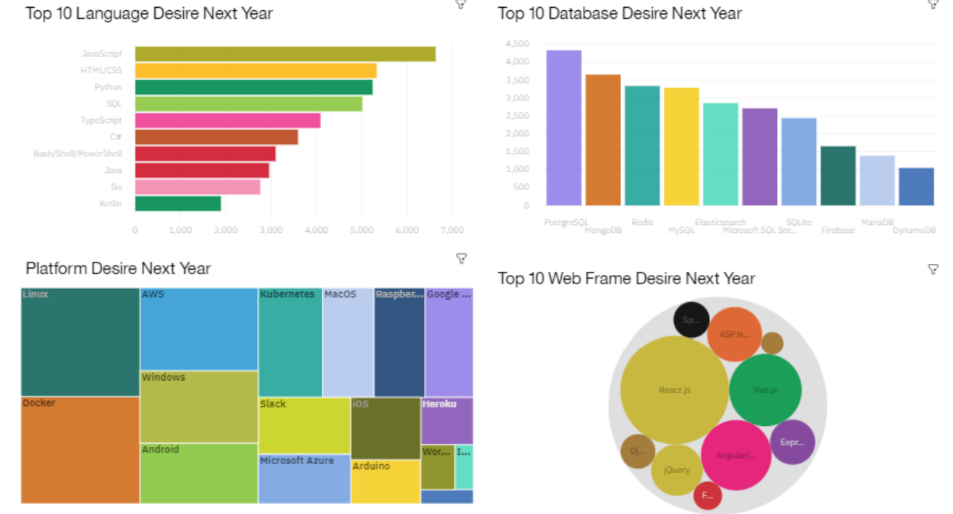
DASHBOARD

Slide 13
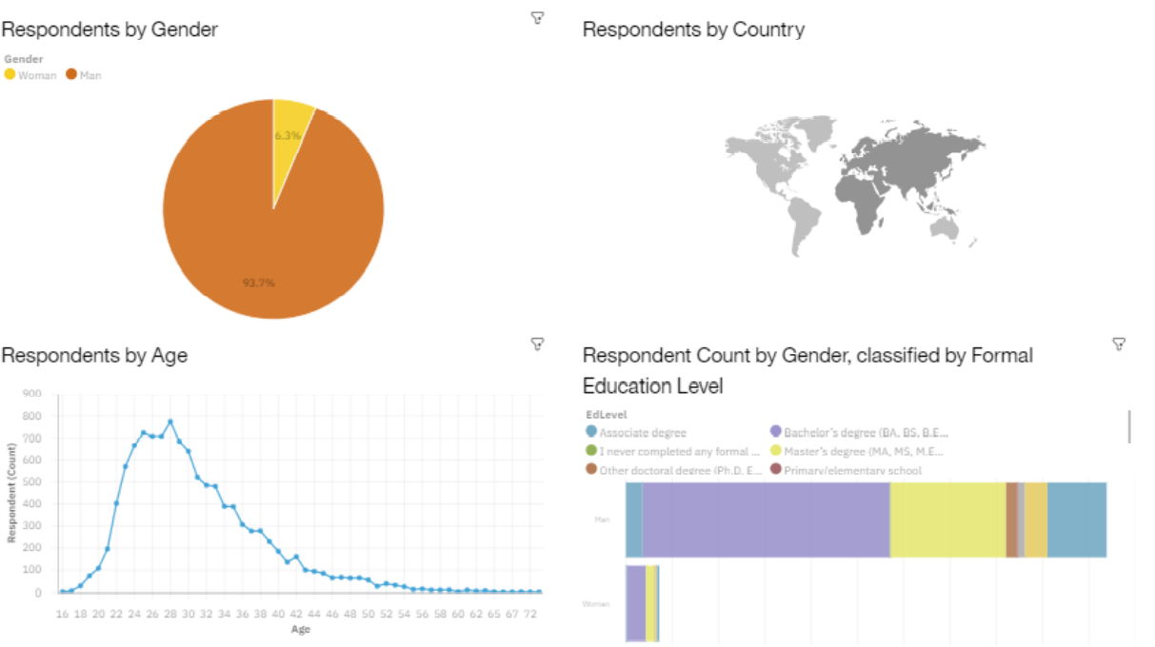
DASHBOARD

Slide 14
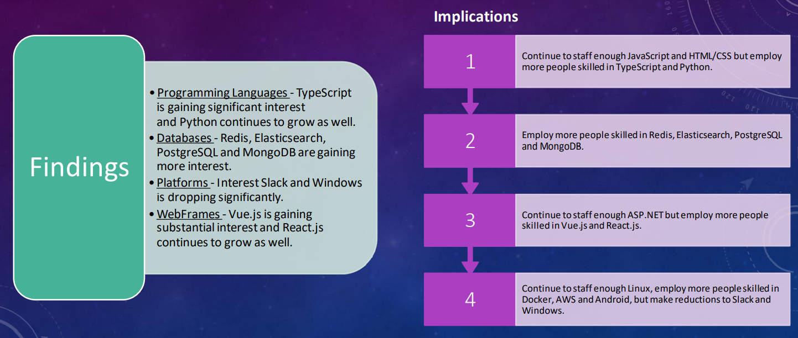
OVERALL FINDINGS & IMPLICATIONS

Slide 15
CONCLUSION
Carve out budget in order to hire additional staff with skills needed to fill any gaps.
Set aside budget or put a program in place to upskill those already employed.
Make adjustments in staff for those skills no longer in demand.

Slide 16
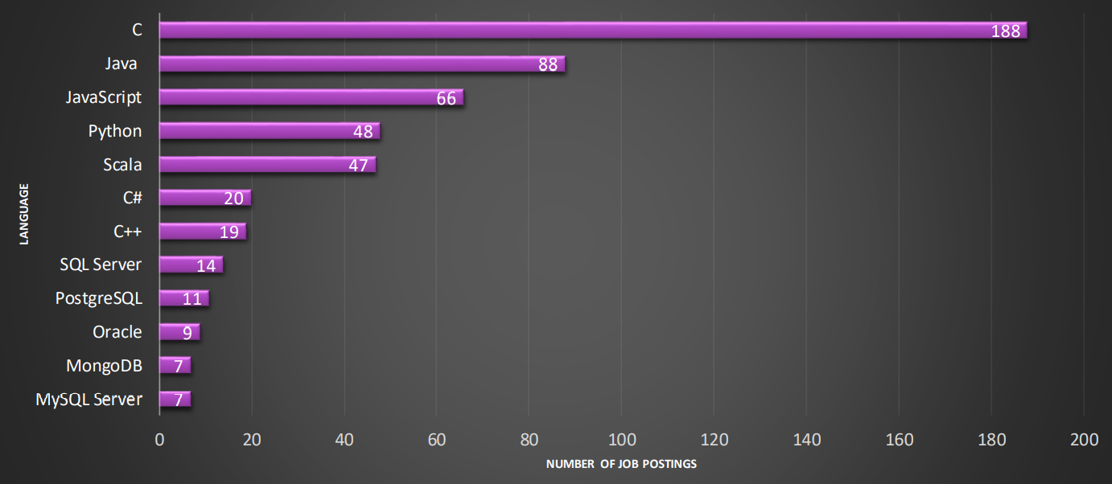
APPENDIX

Slide 17
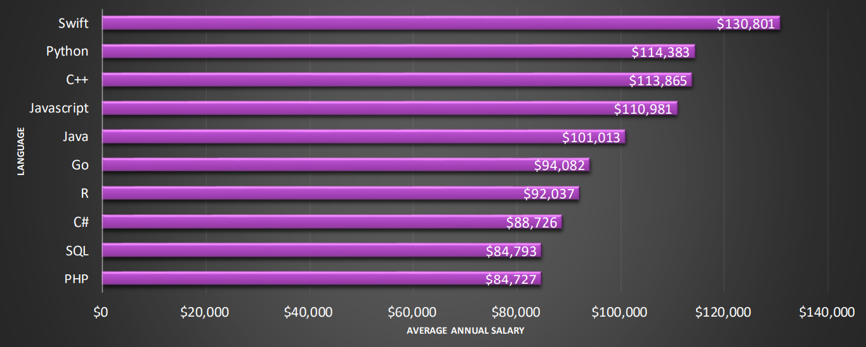
APPENDIX

